Slide 1
M-RETS Subscriber & Regulator Group Meeting
January 30, 2018 2:00-3:00 p.m. CST

Slide 2
AGENDA
Introductions Investor Owned Utilities Municipal Utilities Cooperative Utilities Regulators Marketers, Generators, Aggregators, & Others | 2:00-2:05
Welcome from Subscriber Group Chairs | 2:05-2:10
Feature Release Plan Pre Compliance Season Post Compliance Long Term Plan | 2:10-2:40
Initial Feedback | 2:40-2:50
Improvement Suggestions and Q&A | 2:50-3:00
ADJOURN | 3:00

Slide 3
Introductions
Investor Owned Utilities
Municipal Utilities
Cooperative Utilities
Regulators
Marketers, Generators, Aggregators, & Others

Slide 4
Subscriber Group Co-Chairs
Ursula Norwood, Alliant Energy
Jeff Toye, Manitoba Hydro

Slide 5
THANK YOU
We appreciate your patience
We are doing everything to create a better experience
We increased the capacity of the development team to address the challenges
We welcome your feedback—the positive and negative

Slide 6
Good News
We have October and November MISO data
We are waiting to address one issue before we upload the generation

Slide 7
Release Plans – Compliance Season
We have a laser focus on compliance season
Version 1.2.1 - 02/02/2018
Orgs: Edit Permissions for Existing Users in Org
Accounts:
Create New Accounts
Edit Existing Accounts

Slide 8
Release Plans – Compliance Season
Version 1.2.2 - 02/08/2018
Improved support for generation upload date/time formats
Email Notifications
Successful generation upload summary
Successful REC Retirement summary
Successful REC Transfer summary

Slide 9
Release Plans – Compliance Season
Version 1.3 -Week of intensive testing (2/15) before 1.3 released on 2/22/2018
Projects
View All Project Details
Edit & Submit Project Details
Create & Submit New Project Details

Slide 10
Release Plans – Compliance Season
Version 1.3.2 - 03/1/2018
Reports
UI views for all currently available CSV-based reports
REC Batch specific reports
Include Notes field in Reports
Include Retirement Notes in CSVs

Slide 11
Release Plans – Post Compliance
Parity
Forward Transfers
Global Search
External API Integration

Slide 12
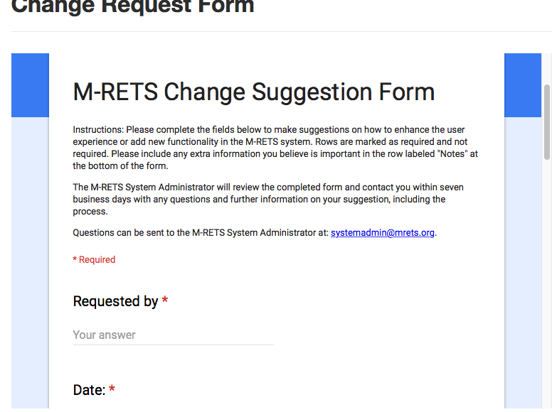
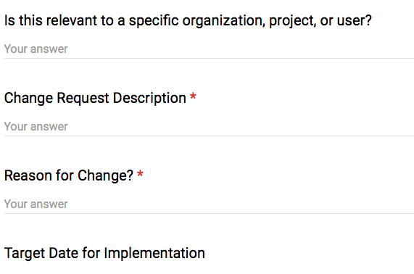
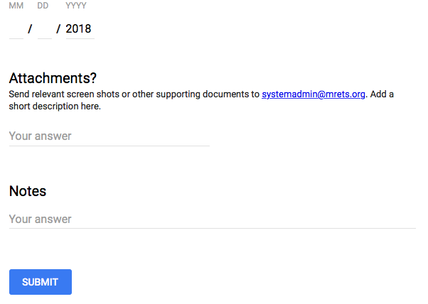
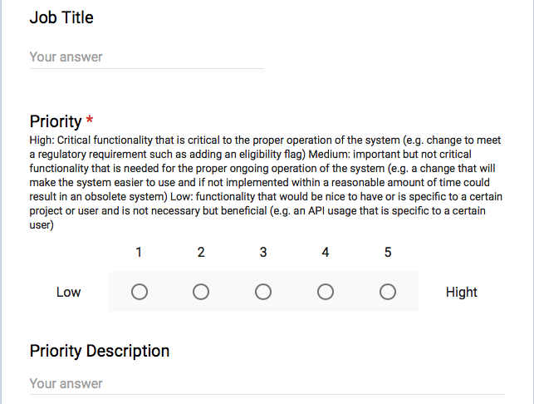
Change Suggestion Form
Now a google form that can be found at: https://www.mrets.org/change-request-form/

Slide 13
Feature Training
We would like to schedule one or two trainings March to review new features and functionality. Both dates will focus on features and functionality and give users options. The first day will focus on features but cover compliance reporting while the second day will focus on compliance reporting but cover features.
Tentative Dates:
Wednesday, March 8th 1 p.m. – 2:30 p.m. CST
Friday, March 9th, 9 a.m. – 10:30 a.m. CST
The last 30 minutes of each session will be open Q&A

